Slide 1
Deep Learning
Intro
Artem Chumachenko

Slide 2
Plan
Intro. PyTorch
Computer Vision
Natural Language Processing
Recommendation system & RL
Tips & Tricks

Slide 3
Homeworks & Grading
6 + 1 works
Every work worth 10 points
Deadline: 2 weeks(!)
Grading:
“3” – at least 3 done HW
“4” – at least 4 done HW
“5” – at least 6 done HW

Slide 4
Contacts
Slack channel:
https://catalyst-team-core.slack.com -> #dl-course-2020
Me:
https://t.me/artek_chumak (pls no)

Slide 5
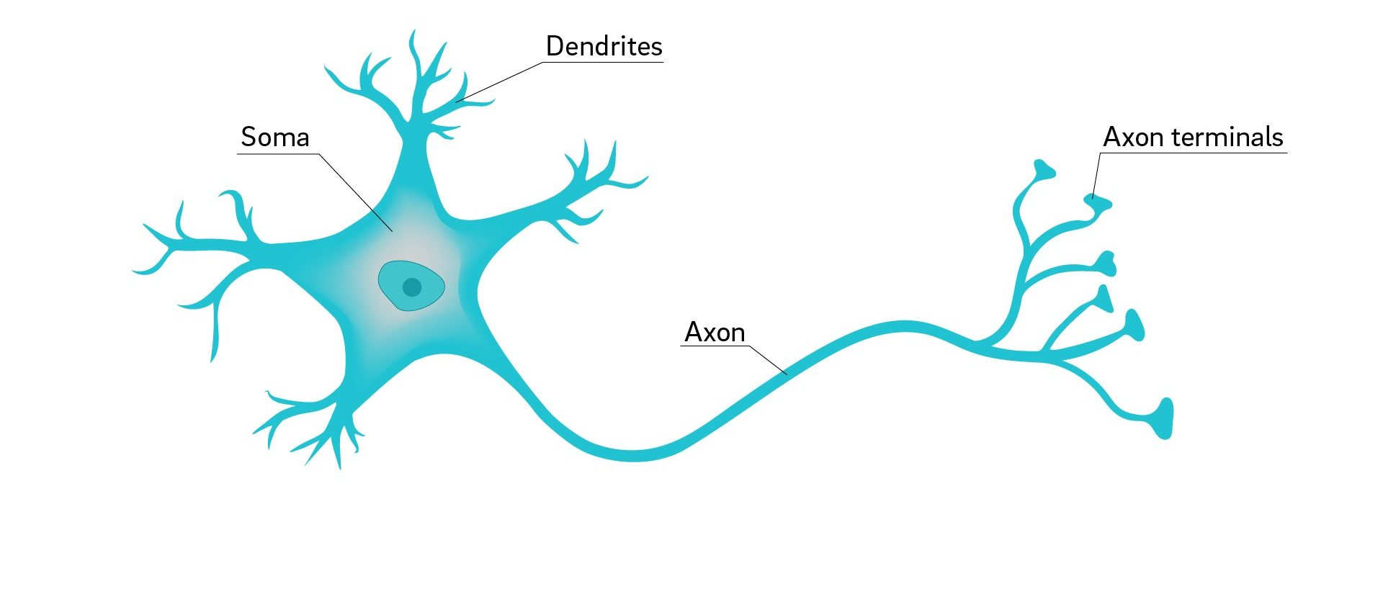
Neurons

Slide 6
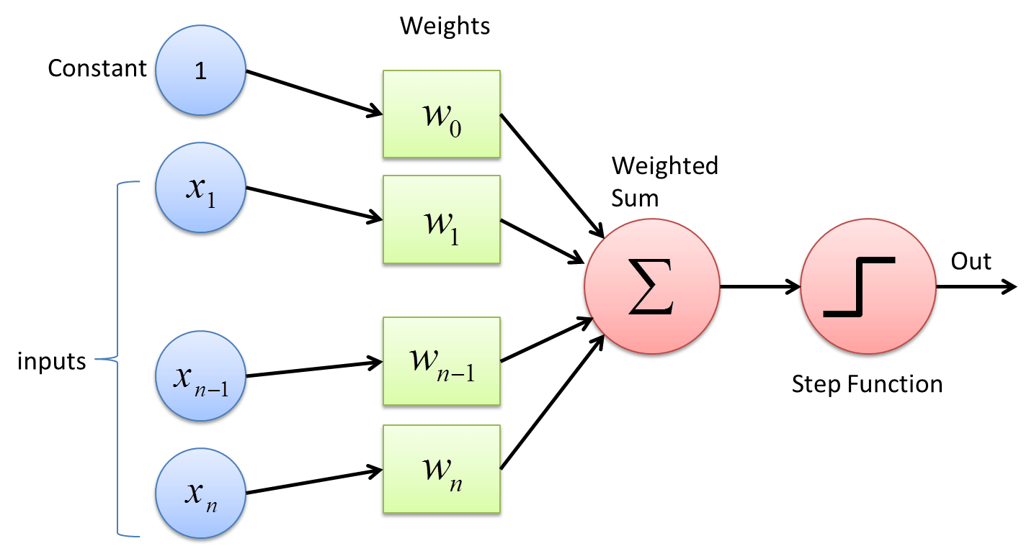
Perceptron

Slide 7
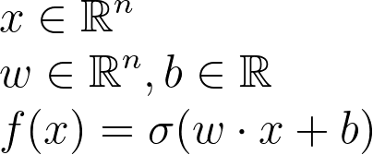
Perceptron

Slide 8
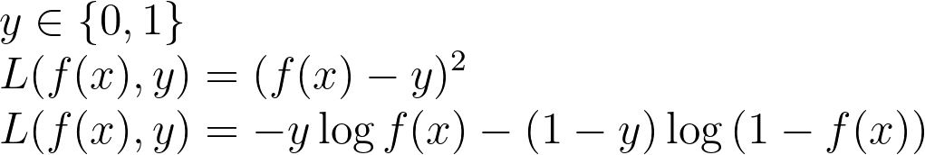
Loss function

Slide 9
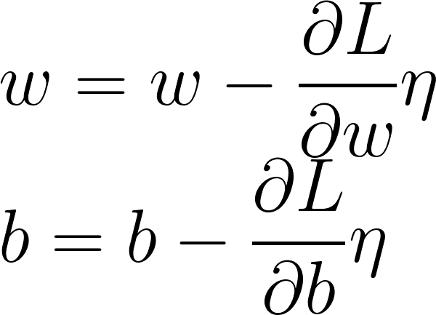
Gradient Descent

Slide 10
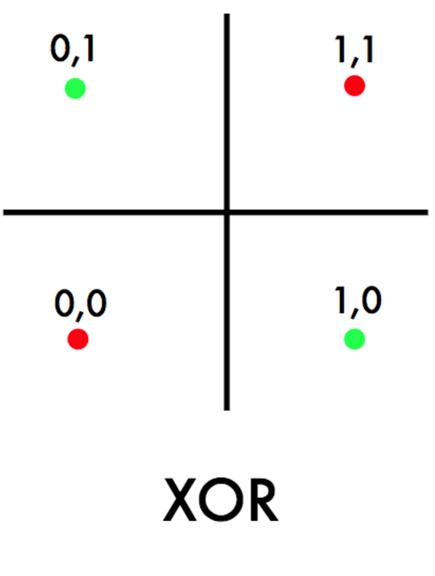
XOR problem

Slide 11
Perceptron

Slide 12
Perceptron

Slide 13
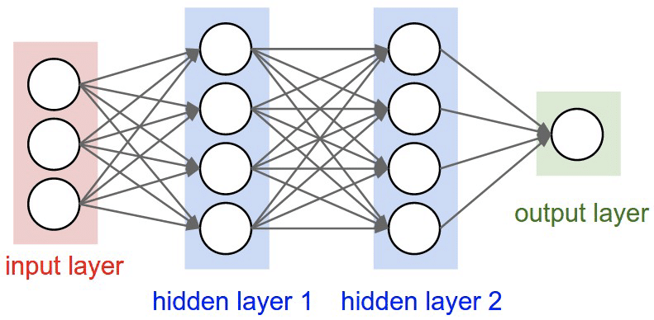
Deep Network

Slide 14
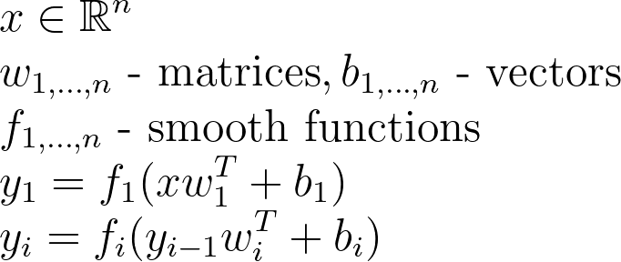
Deep Network

Slide 15
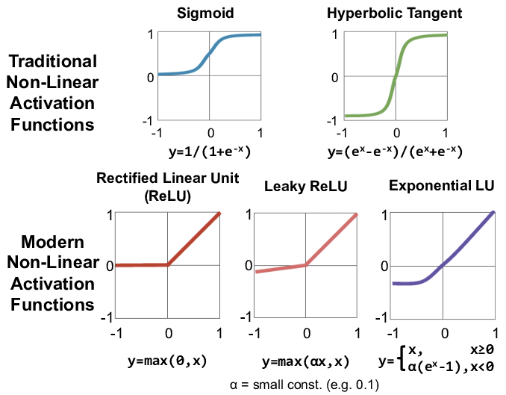
Activation function

Slide 16
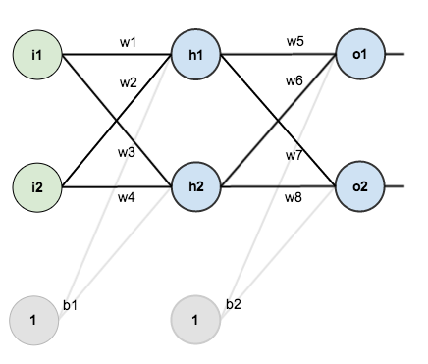
Back Propagation

Slide 17
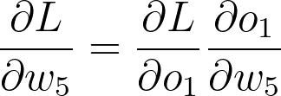
Back Propagation

Slide 18
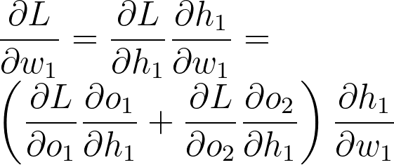
Back Propagation

Slide 19
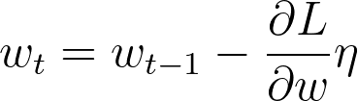
Optimizers
https://mlfromscratch.com/optimizers-explained

Slide 20
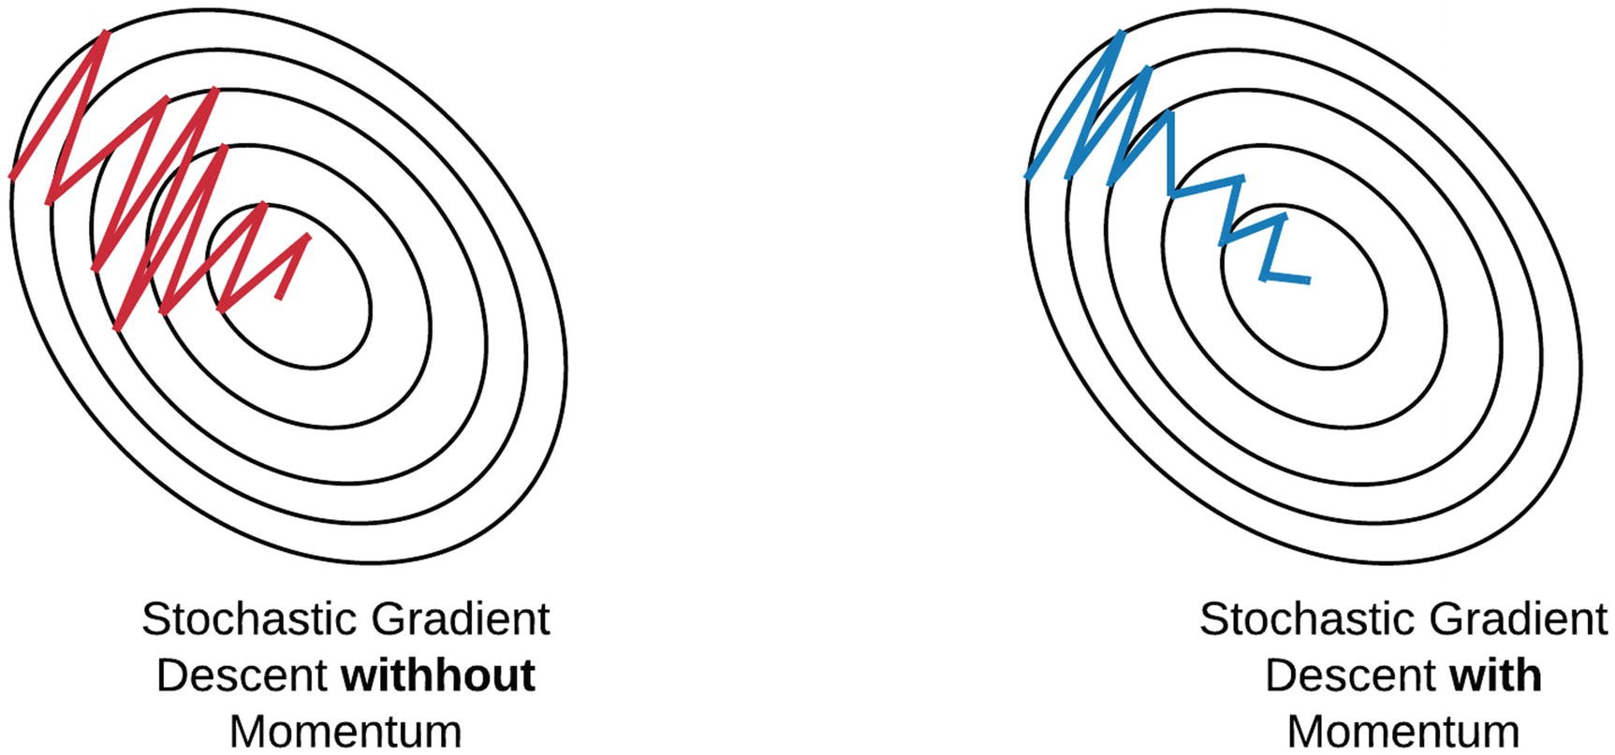
Optimizers
https://mlfromscratch.com/optimizers-explained

Slide 21
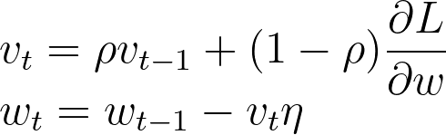
Momentum

Slide 22
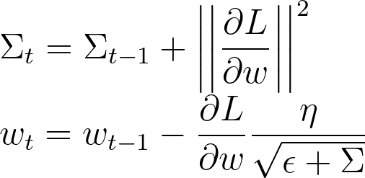
Adaptive learning rate

Slide 23
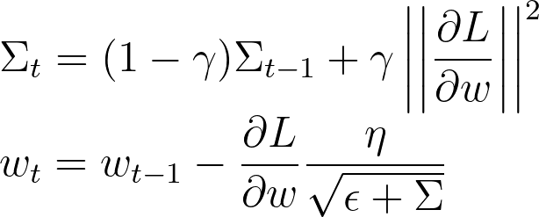
RMSProp

Slide 24
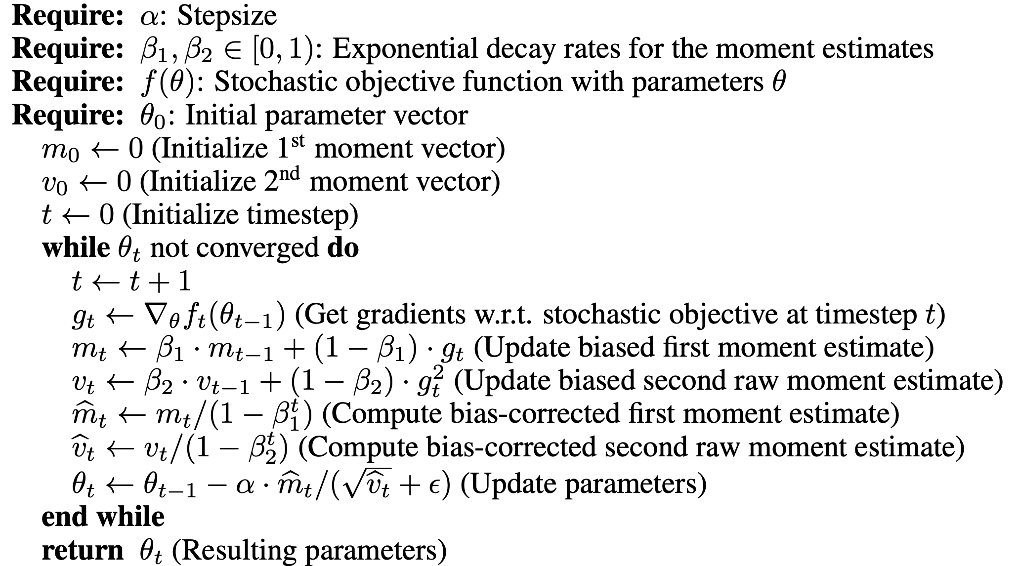
Adam

Slide 25
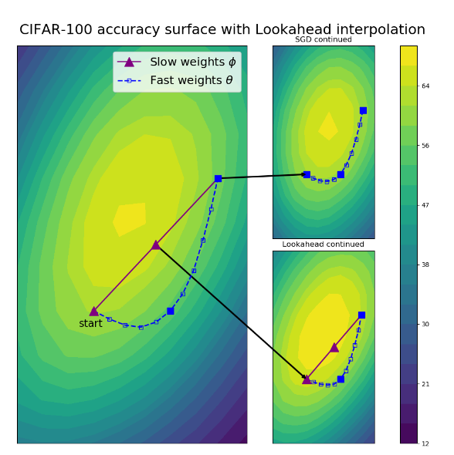
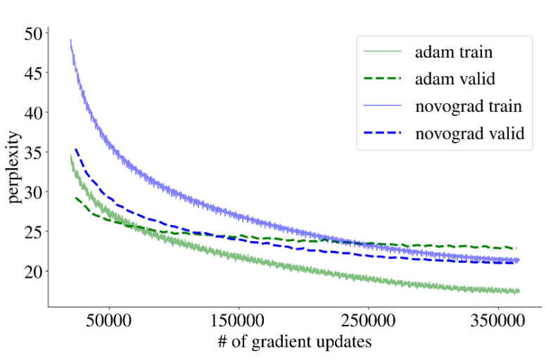
Overkill: RAdam, Look-a-head, Novograd

